Slide 1
FOOD DELIVERY APPLICATION CAPSTONE PROJECT
Prepared By
Ashim Aakash Roy
Ashutosh Kumar

Slide 2





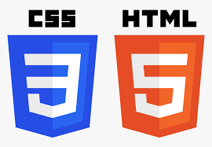






TECHNOLOGIES IMPLEMENTED
FRONT-END
BACK-END
MISCELLANEOUS

Slide 3
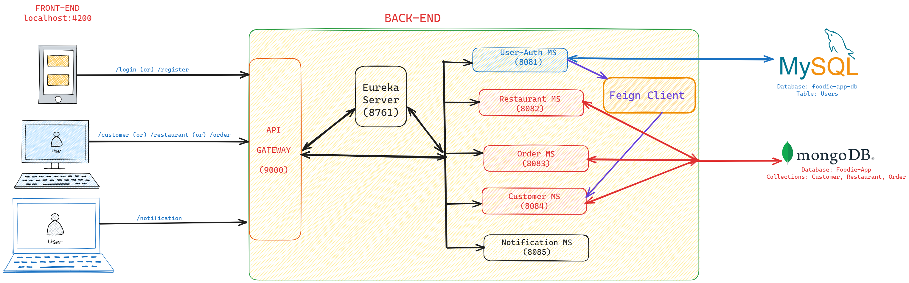
ARCHITECTURE DIAGRAM

Slide 4
BACK-END MODULE
Implements Spring Boot as the web based framework of JAVA
Follows Micro-service based architecture
Micro-services included in Backend module:
1. Customer Auth (Port# 8081)
2. Customer Service (Port# 8082)
3. Restaurant Service (Port# 8083)
4. Order Service (Port# 8084)
5. Eureka Server (Port# 8761)
6. API Gateway (Port# 9000)

Slide 5
IMPORTANT FILES
Dockerfile: It is a document containing all the commands the user requires to call on the command line to assemble an image
application.yml: It is primarily used to modify configuration parameters, such as connectivity with database, port number, eureka registry etc.
pom.xml: It is used to keep a track of project details such as group ID, artifact ID, and also all the list of dependencies required
compose.yaml: It is used to run multi-container docker application.

Slide 6
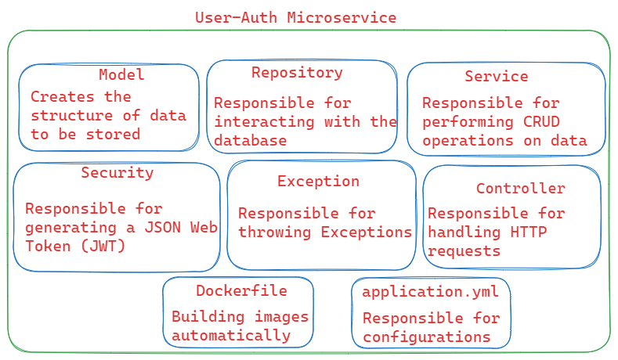
CUSTOMER AUTH
Purpose:
Allows new Users to register
Allows registered user to login
Generates a JSON Web Token (JWT), whenever a registered user logs in
Customer Details are stored in MySQL Database

Slide 7
CUSTOMER SERVICE

Slide 8
RESTAURANT SERVICE

Slide 9
ORDER SERVICE

Slide 10
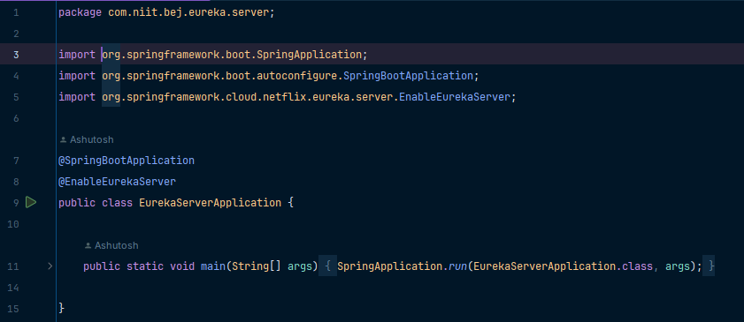
EUREKA SERVER

Slide 11
API GATEWAY

Slide 12
FRONT-END MODULE
Developed by using Angular, a free web based JS framework
Angular is primarily used to develop Single Page Applications (SPA)
WHY ANGULAR ?
1. Custom Components
2. Dependency Injection (DI)
3. Device Compatibility & Seamless User Experience

Slide 13
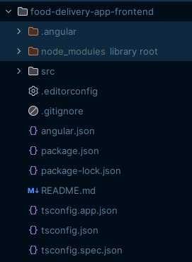
IMPORTANT FILES
angular.json: Stores information about the architecture, dependencies, build and test configurations
package.json: It is a file that contains information about the project and its dependencies
tsconfig.json: It specifies the base Typescript and Angular compiler options
app.module.ts: Maintains a track of all components and imports, required in the project
app-routing.module.ts: Specifies what component to be loaded, when a specific path is entered

